Slide 1

Information-Retrieval Search Engine Project
By Victor Gavrilenko & Ilay Cohen

Slide 2
Preprocessing 1:
Wikipedia dump files
Google Cloud
Created multiple .bin files as words-to-article_id data structure
A.K.A Inverted index
Then created .pkl file as word-to-bin_file data structure
Uploaded to
Using PySpark

Slide 3
Preprocessing 2:
Google Cloud
Inverted Index, Title length Dictionary and Doc id to Title Dictionary
Title
Tokenize, Stopwords & Stem
Doc Body
Tokenize, Stopwords & Stem
Inverted Index, Doc L2 Norm Dictionary and Body Length Dictionary
Anchor Text
Page Rank Dictionary
Page View Dictionary

Slide 4
Preprocessing 3:
Running Python server using Flask on google cloud cluster
Loads all .pkl files from the google cloud
bucket
Waits for user input

Slide 5
During Runtime:
User
Result as Json
Server:
Query
GCP
Redistributing weight based on if query is question or not
Similarity based on BM25 algorithm
Sorting results and slicing for best 30
Tokenizing and stemming
Title
Body

Slide 6
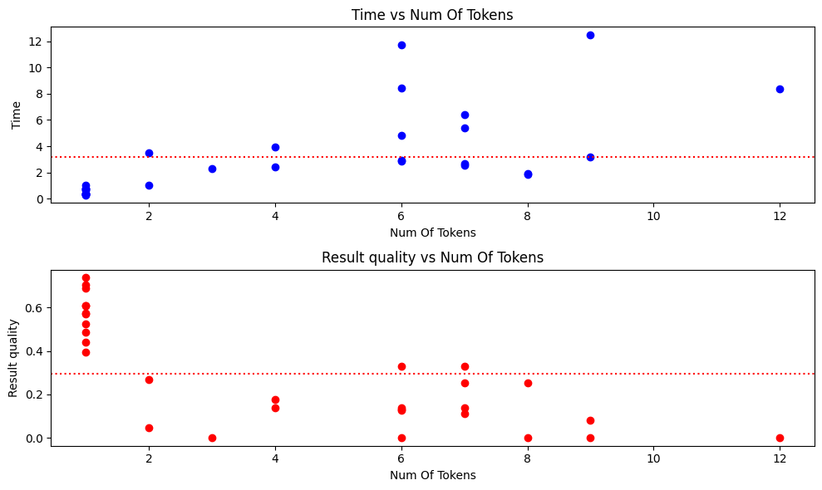
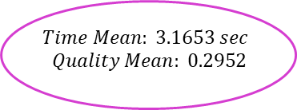
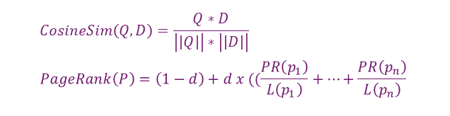
First Experiment – Cosine Similarity & Page Rank
Body Cosine Similarity
Return Best N Results
Merge Results:
Title Weight: 0.7
Body Weight: 0.3
Query
Tokenize, Stopwords & Stem
Title TF + PageRank
$$CosineSim\left(Q,D\right)=\frac{Q∗D}{\left|\left|Q\right|\right|∗\left|\left|D\right|\right|} \\ PageRank\left(P\right)=\left(1−d\right)+d x ((\frac{PR\left(p_{1}\right)}{L\left(p_{1}\right)}+…+\frac{PR\left(p_{n}\right)}{L\left(p_{n}\right)}$$
$$Time Mean: 3.1653 sec$$
$$Quality Mean: 0.2952$$

Slide 7
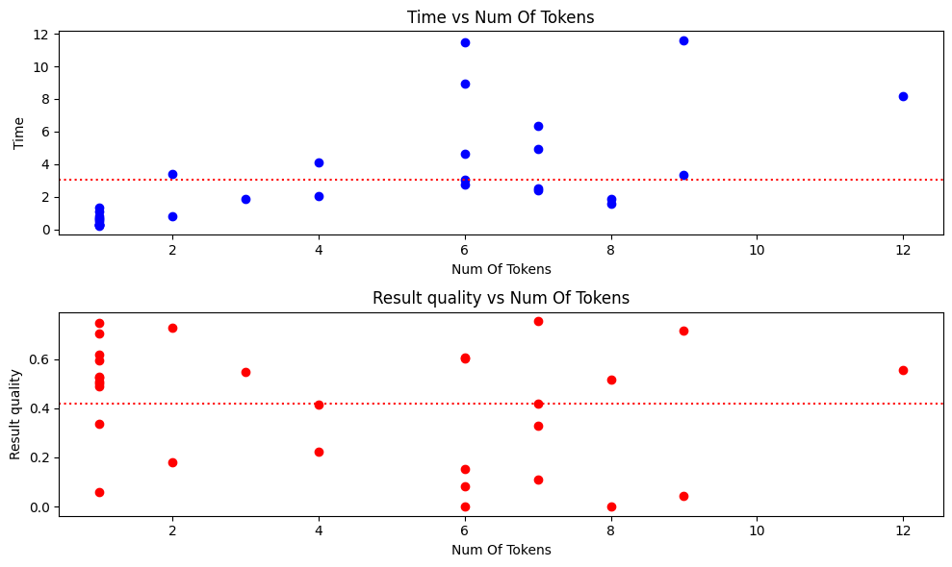
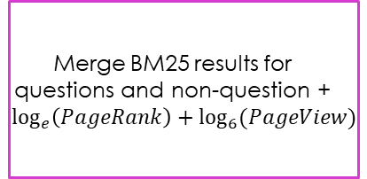
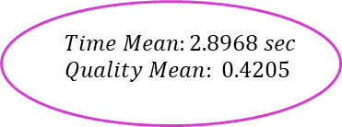
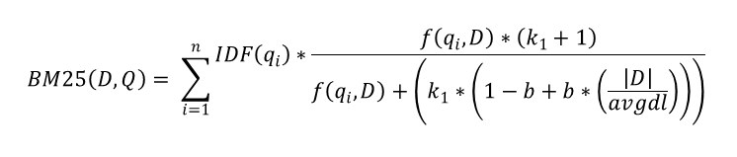
Second Experiment – BM25 with Page Rank & Page Views
Body MB25 with k1=1.75 & b=0.65
Merge BM25 results for questions and non-question + $\log_{e}\left(PageRank\right)+\log_{6}{(PageView)}$
Return Best N Results
Query
Tokenize, Stopwords & Stem
Title BM25 with k1 =2.2 & b=0.85
$$Time Mean:2.8968 sec$$
$$Quality Mean: 0.4205$$
$$BM25\left(D,Q\right)= \sum_{i=1}^{n}{\begin{aligned}IDF\left(q_{i}\right)∗\frac{f\left(q_{i},D\right)∗\left(k_{1}+1\right)}{f\left(q_{i},D\right)+\left(k_{1}∗\left(1−b+b∗\left(\frac{\left|D\right|}{avgdl}\right)\right)\right)} \\ \end{aligned}}$$

Slide 8
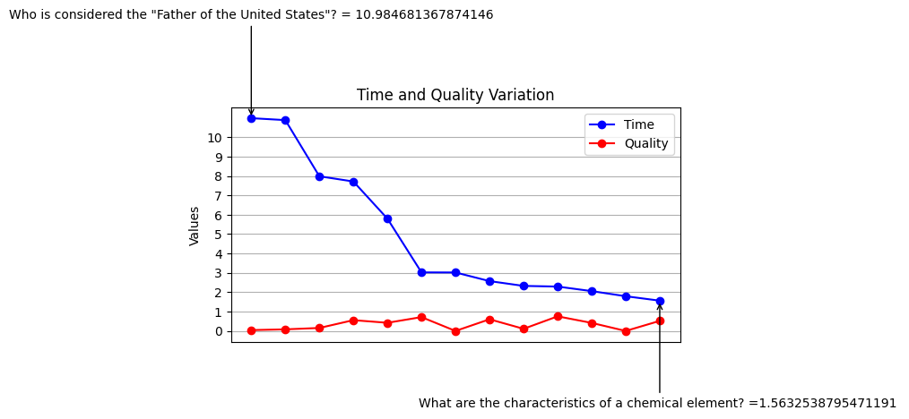
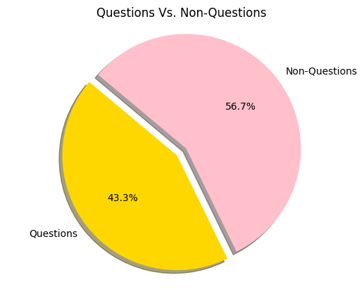
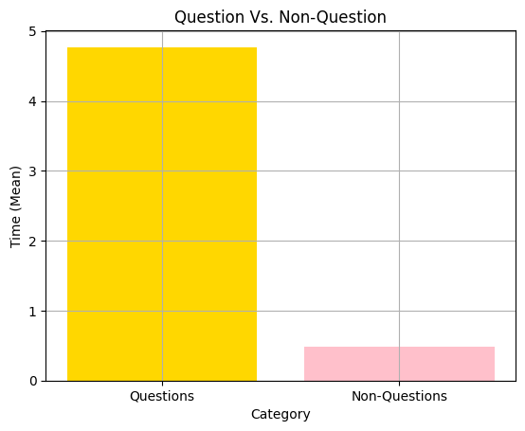
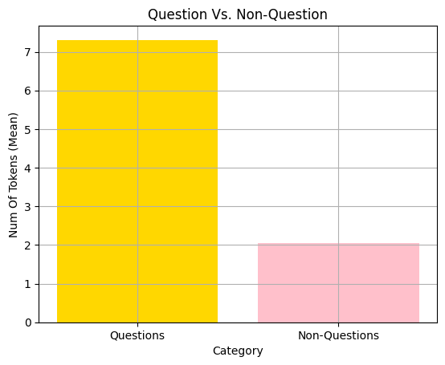
Understanding Poor Results:
['state', 'unit', 'consid', 'father'] ['element', 'chemic', 'characterist']

